Slide 1
From Idea to Production: The Build Is Sacred in Dynamics 365 F&O
Automated F&O Package Promotion from Commit to Production
Notes:
**If running long:** Trim "Environment Automation" — point to docs/repo.
**If running short:** Expand "When Things Go Wrong" with audience horror stories — everyone has one.

Slide 2
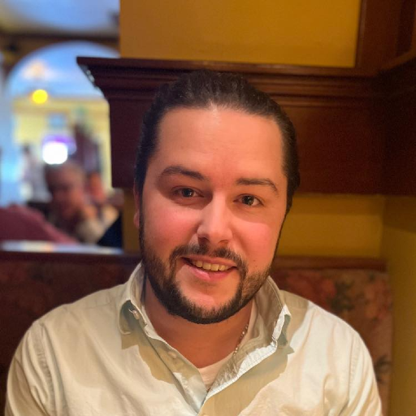
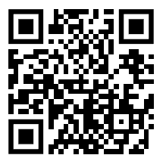

Lane Swenka
Microsoft
Nathan Clouse
HSO Everything we’re going to talk about about is available at https://github.com/NathanClouseAX/d365fo-cicd-ppac
Notes:
**interaction** ask about who is doing any of the following - [ ] At least one completed build → deploy → release chain to show artifact flow
- [ ] PPAC admin center showing environment operations history
- [ ] Pipeline run history showing the progression through environments
- [ ] Slide showing LCS workflow vs pipeline workflow side-by-side
- [ ] Backup screenshots in case live demo fails

Slide 3
THE QUESTION
"How many of you have deployed a package to production and weren't 100% sure it was the same binary that passed UAT?"
The promise: one artifact, created once, carried forward untouched — or rolled back with certainty.

Slide 4
WHAT WE'LL COVER
Immutable packaging and durable versioning
Artifact promotion through environments
Structural enforcement (not just process)
Full environment automation via PPAC
What we won't cover:
X++ patterns, Dataverse solutions, Power Platform ALM

Slide 5
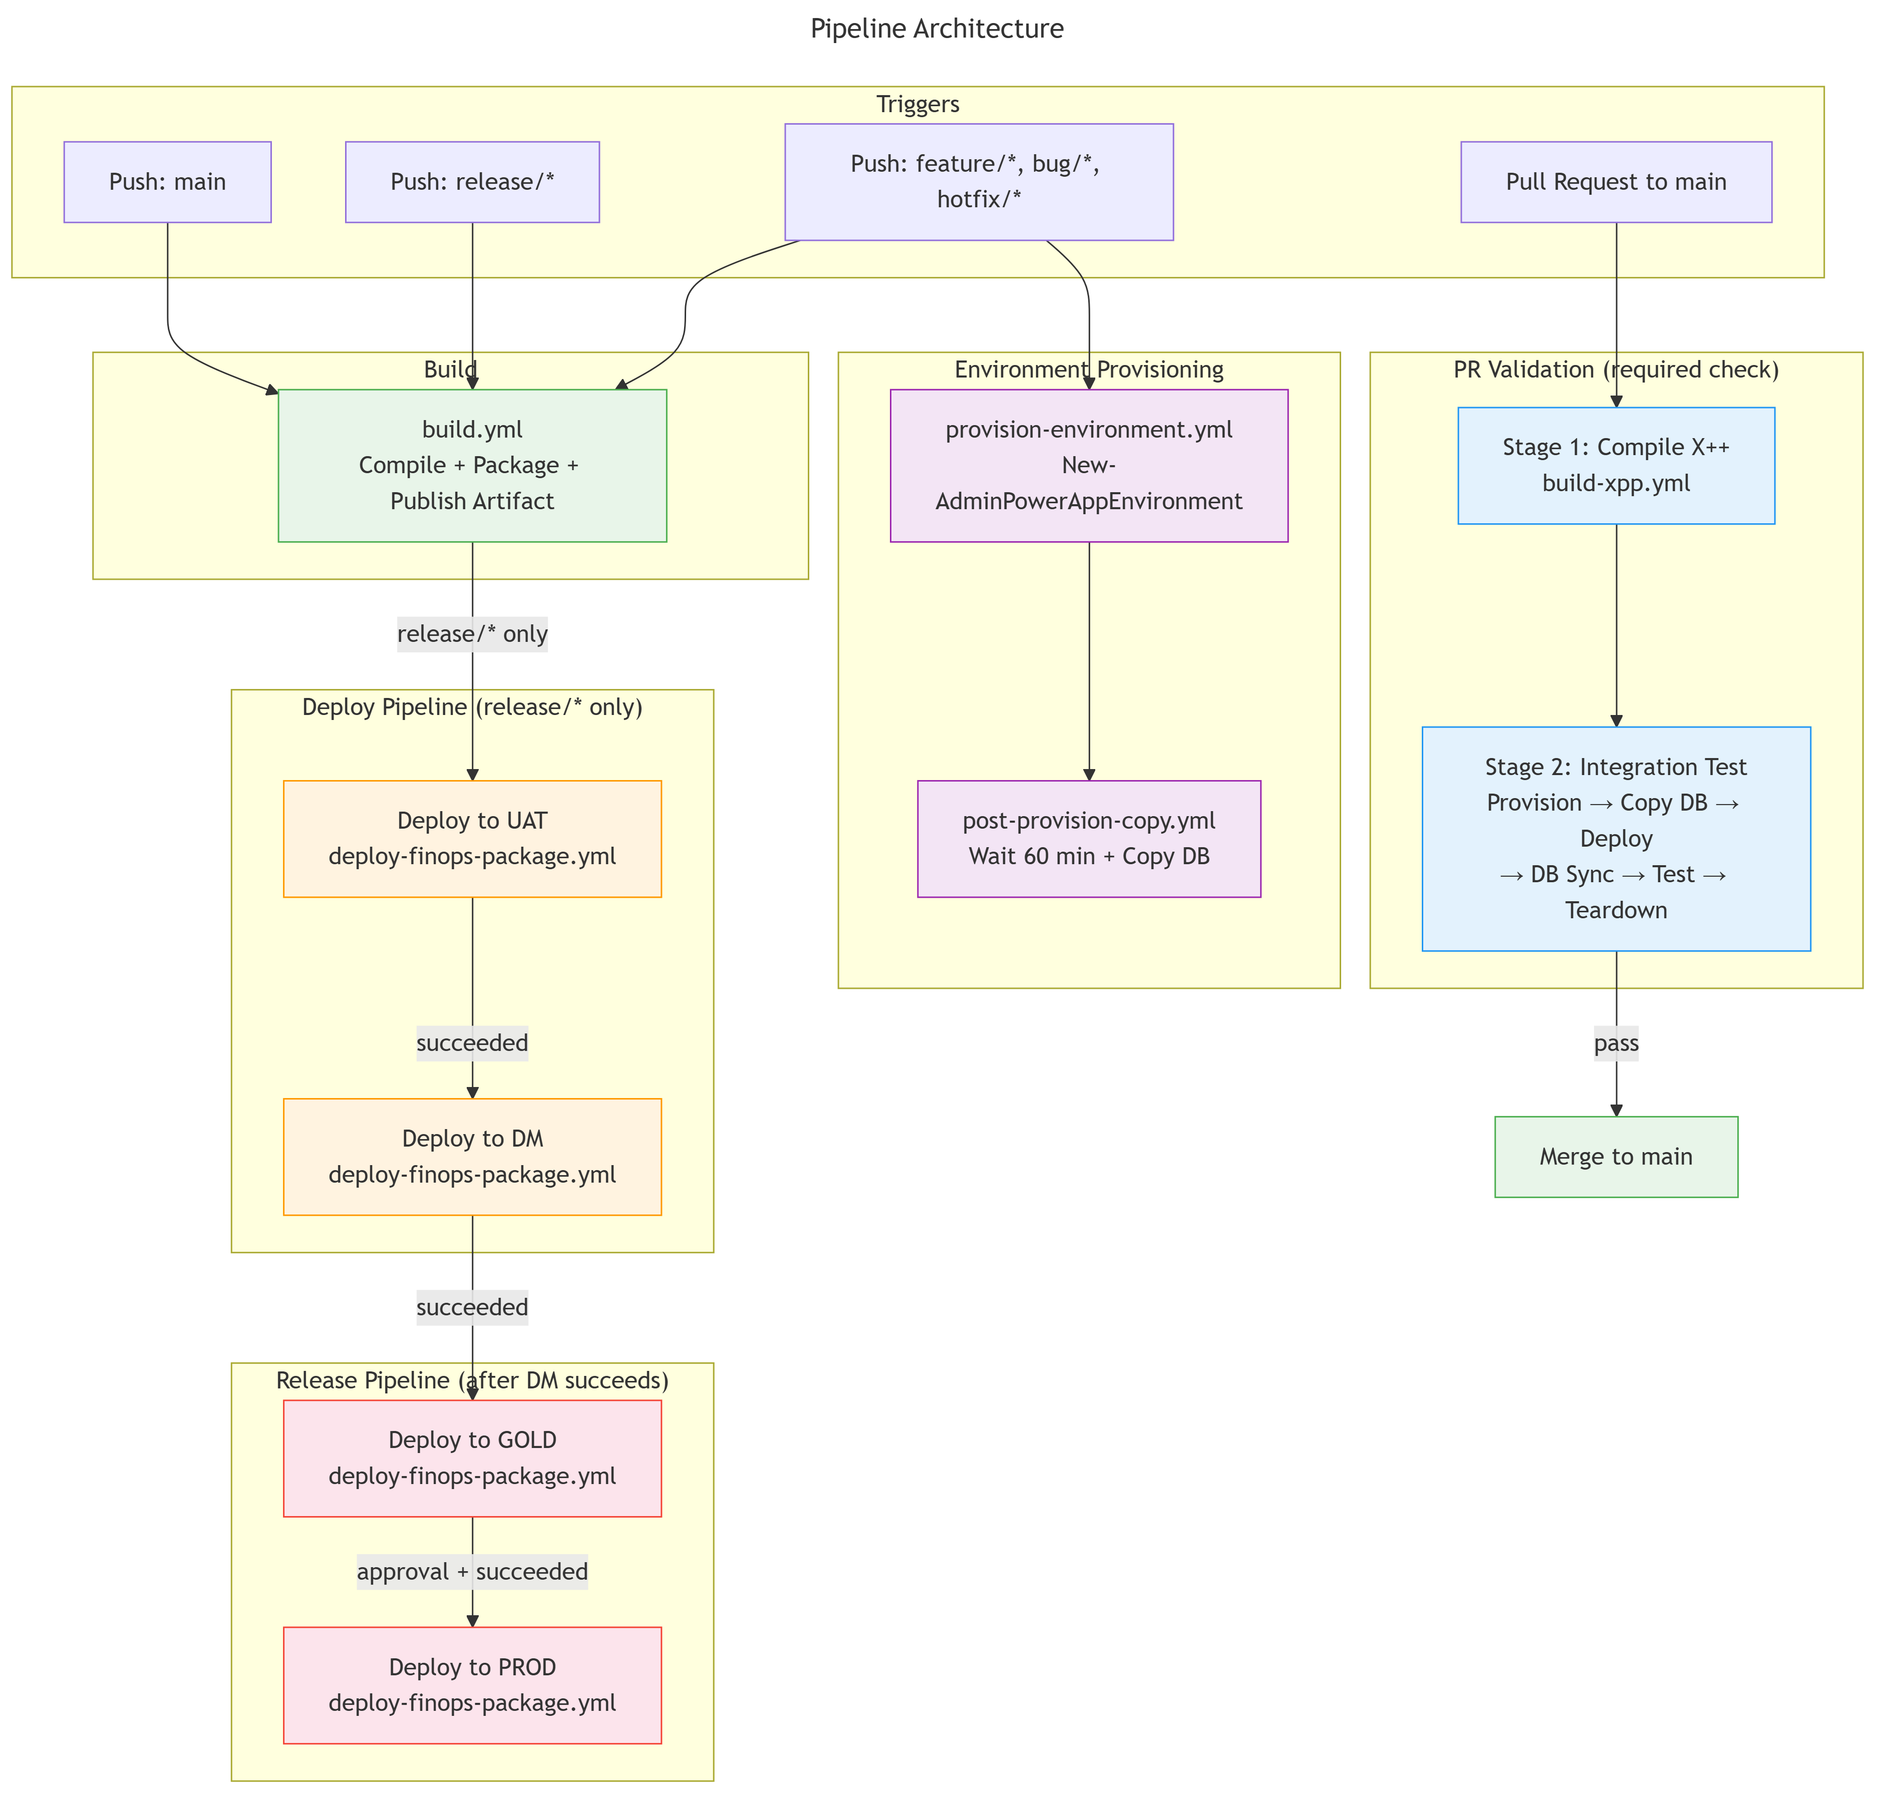
THE BIG PICTURE

Slide 7
WHY LCS CAN'T GET YOU THERE
LCS was designed for a different era. The world moves on.

Slide 8
LCS vs WHAT WE WANT
LCS Reality:
Manual portal deployments
Build VMs (~$500/mo)
Upload to Asset Library
No automated PR validation
Portal provisioning
What We Want:
API-driven, pipeline-triggered
Hosted agents, pay-per-minute
One artifact flows untouched
Full integration test on every PR
Branch push = sandbox in minutes

Slide 9
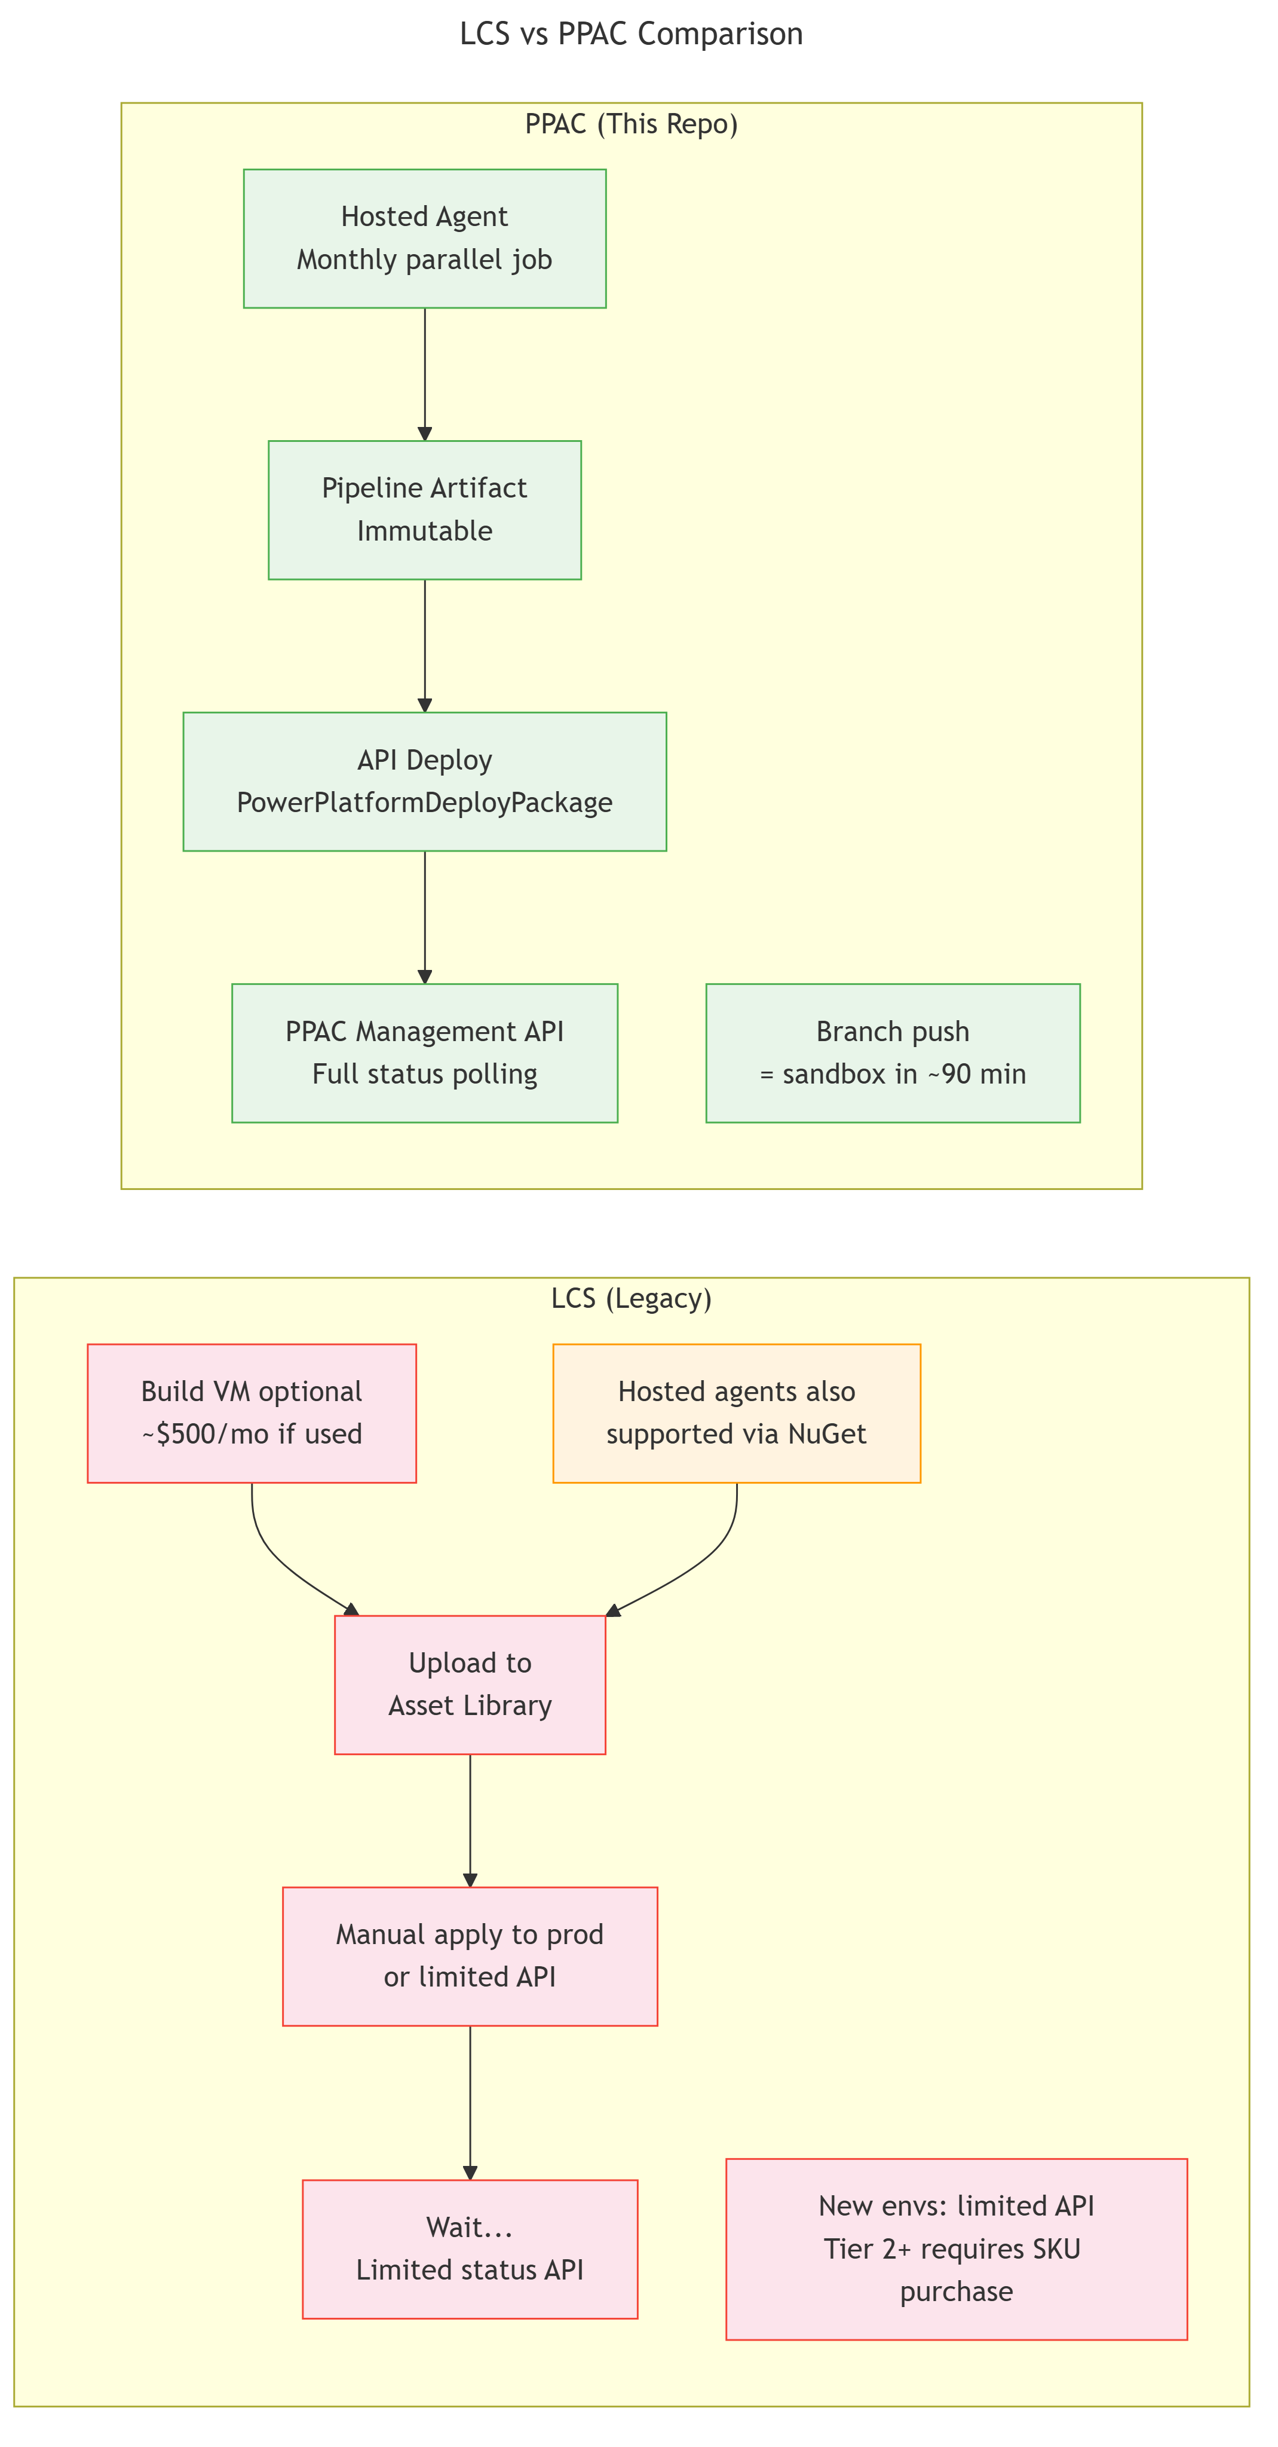
LCS vs PPAC
Notes:
LCS isn't going away tomorrow, but PPAC APIs are where all the new investment is. This is the direction.

Slide 10
P P A C
Notes:
LCS isn't going away tomorrow, but PPAC APIs are where all the new investment is. This is the direction.

Slide 11
LCS
Notes:
LCS isn't going away tomorrow, but PPAC APIs are where all the new investment is. This is the direction.

Slide 12
LCS vs PPAC
Notes:
LCS isn't going away tomorrow, but PPAC APIs are where all the new investment is. This is the direction.

Slide 13
THE IMMUTABLE ARTIFACT
The package is created exactly once. Everything after that is promotion.

Slide 14
HOW THE ARTIFACT IS BUILT
Compiled from source on hosted agents (no build VM)
NuGet DevALM packages provide the toolchain
Version number baked into module metadata at compile time
Published as a pipeline artifact — immutable from this point
Same binary in UAT, DM, GOLD, PROD

Slide 15
WHY IMMUTABILITY MATTERS
If UAT passes and GOLD fails — it's environmental, not build variance
Rollback = deploy a known-good artifact (not rebuild from a commit)
Auditors trace any production binary to the exact source commit
Cache invalidates on version bump — no dependency drift
The compilation environment is deterministic and versioned

Slide 16
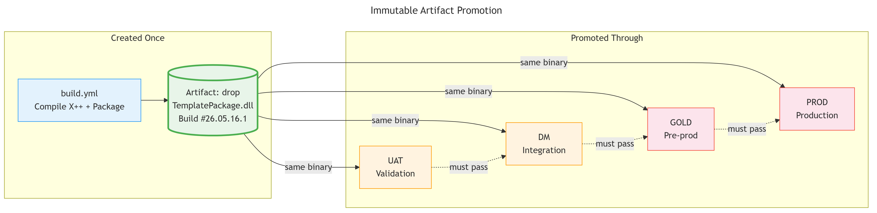
ARTIFACT PROMOTION

Slide 17
BRANCH STRATEGY & ENFORCEMENT
Branches control where code CAN go. Pipelines control where it DOES go.

Slide 18
THE PROMOTION MODEL
feature/* → PR (integration test) → main
main → release/* → UAT → DM → GOLD → PROD
Every PR runs a full integration test:
Provision ephemeral sandbox
Copy database from known-good source
Deploy package + DB sync
Run automated tests
Tear down (always, even on failure)

Slide 19
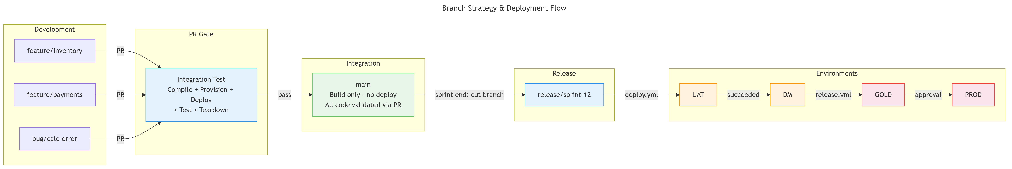
BRANCH STRATEGY

Slide 20
BRANCH STRATEGY

Slide 21
BRANCH STRATEGY

Slide 22
BRANCH STRATEGY

Slide 23
PR AS THE QUALITY GATE
By the time a release branch is cut from main, every commit has already been validated in a real F&O environment.
UAT deployment is for business acceptance, not for catching regressions.
"Process" means someone has to remember.
"Structure" means they can't forget.
Notes:
Every PR to main runs a full integration test:
1. Provision ephemeral sandbox
2. Copy database from known-good source
3. Deploy the package + DB sync
4. Run automated tests
5. Tear down (always, even on failure)
**Key insight:** By the time a release branch is cut from main, every commit has already been validated in a real F&O environment. The UAT deployment is for business acceptance, not regression catching.

Slide 24
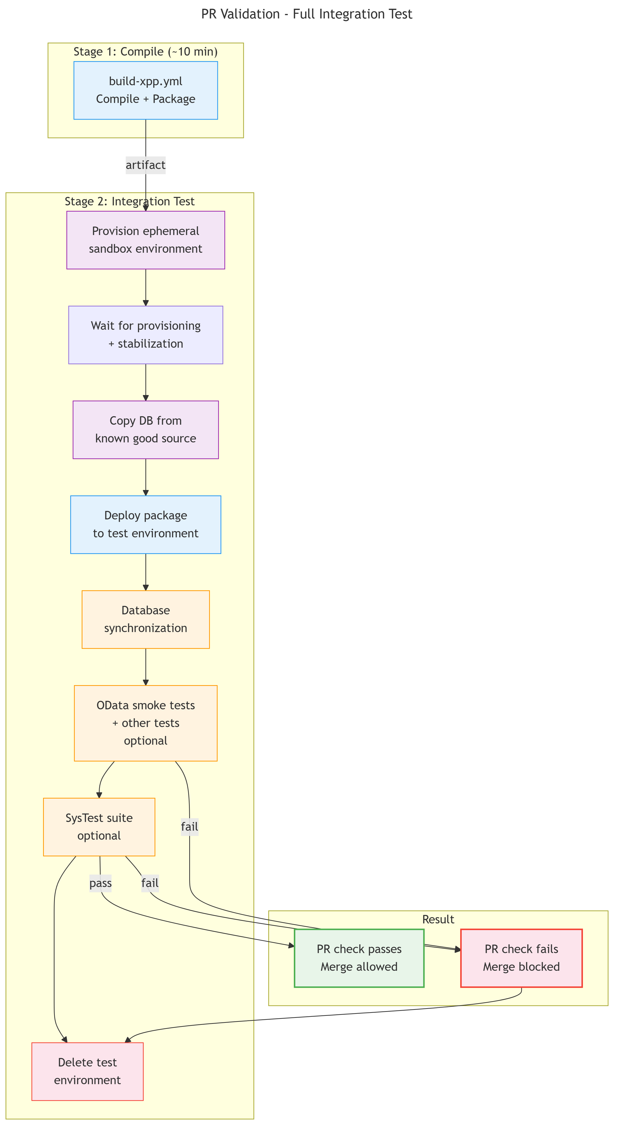
PR VALIDATION FLOW

Slide 27
PR VALIDATION FLOW

Slide 28
STRUCTURAL ENFORCEMENT
PR gate must pass → main never has untested code
Deploy only triggers from release/* → main can't reach UAT (or PROD)
Release chains off deploy success → can't skip validation
Service connections have branch restrictions
Production credentials only issued to release branches
The artifact never changes — only its fate does
Notes:
**Talking point:** "Process" means someone has to remember. "Structure" means they can't forget.

Slide 29
THE DEPLOY PATTERN
Deploy once, verify independently, fail fast for downstream.

Slide 30
THE TWO-JOB PATTERN
Job 1: Submit & Wait
Readiness check (is environment deployable?)
Deploy package (synchronous wait)
Report outcome
Job 2: Verify
Independent status check via management API
Notify stakeholders
Gate downstream environments
Notes:
- Before deploying, poll the environment state
- Environments can be in "Servicing" from Microsoft updates or prior operations
- Without a readiness check: instant failure, manual retry, wasted time
With it: the pipeline waits gracefully, deploys when ready
- The agent must stay connected until the platform confirms completion
- Fire-and-forget = failed deployments you don't know about
- Don't trust the deploy task's exit code alone
- Query the management API independently — what does the platform actually say?
- This is the gate for downstream: GOLD only proceeds if DM verification passes

Slide 31
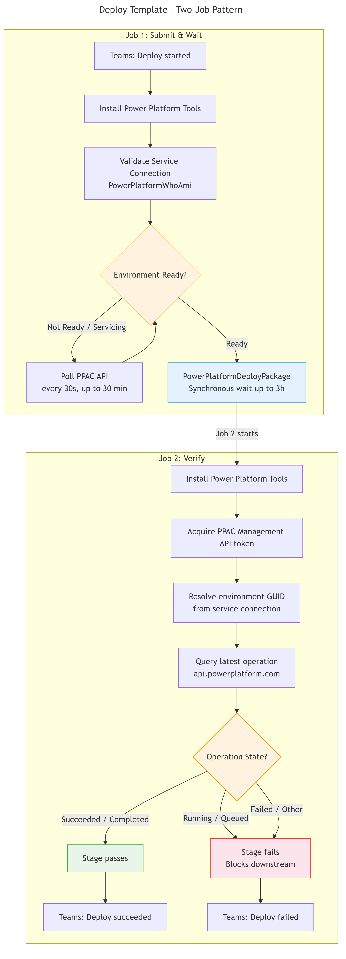
DEPLOY TEMPLATE

Slide 34
DEPLOY TEMPLATE

Slide 35
READINESS & SYNCHRONOUS WAIT
Environment Readiness:
Poll state before deploying
Wait for Servicing/Updating
Deploy when ready
Without: instant failure
Synchronous Wait:
Agent disconnects = PPAC cancels
Must stay connected until done
Fire-and-forget = silent failure
3-hour timeout, poll internally

Slide 36
ENVIRONMENT AUTOMATION
Everything LCS did manually, PPAC does via API.

Slide 37
BRANCH-TRIGGERED PROVISIONING
Push a feature branch → sandbox provisioned automatically
F&O template applied, ready in 150-300 minutes
Database copied from known-good source
Developer codes and tests against real data from day one
PR merged → sandbox deleted → release storage
Zero infrastructure to manage
Notes:
### Branch-triggered provisioning
- Push a feature branch → pipeline provisions a sandbox automatically
- Environment ready in 15-30 minutes with F&O template applied
- Developer gets a real environment with no portal clicks, no support tickets
### Database copy as a pipeline step
- After provisioning, copy data from a known-good source automatically
- Same mechanism for: sandbox initialization, UAT refresh, pre-release GOLD refresh
- Developers test against real data from day one
### DMF entity refresh
After deploying new data entities, trigger a DMF entity refresh
- Automated — no manual "publish all entities" step
Requires the service principal registered as an F&O application user (common gotcha)
More automation options like enable dual write helper (DWHelper)

Slide 38
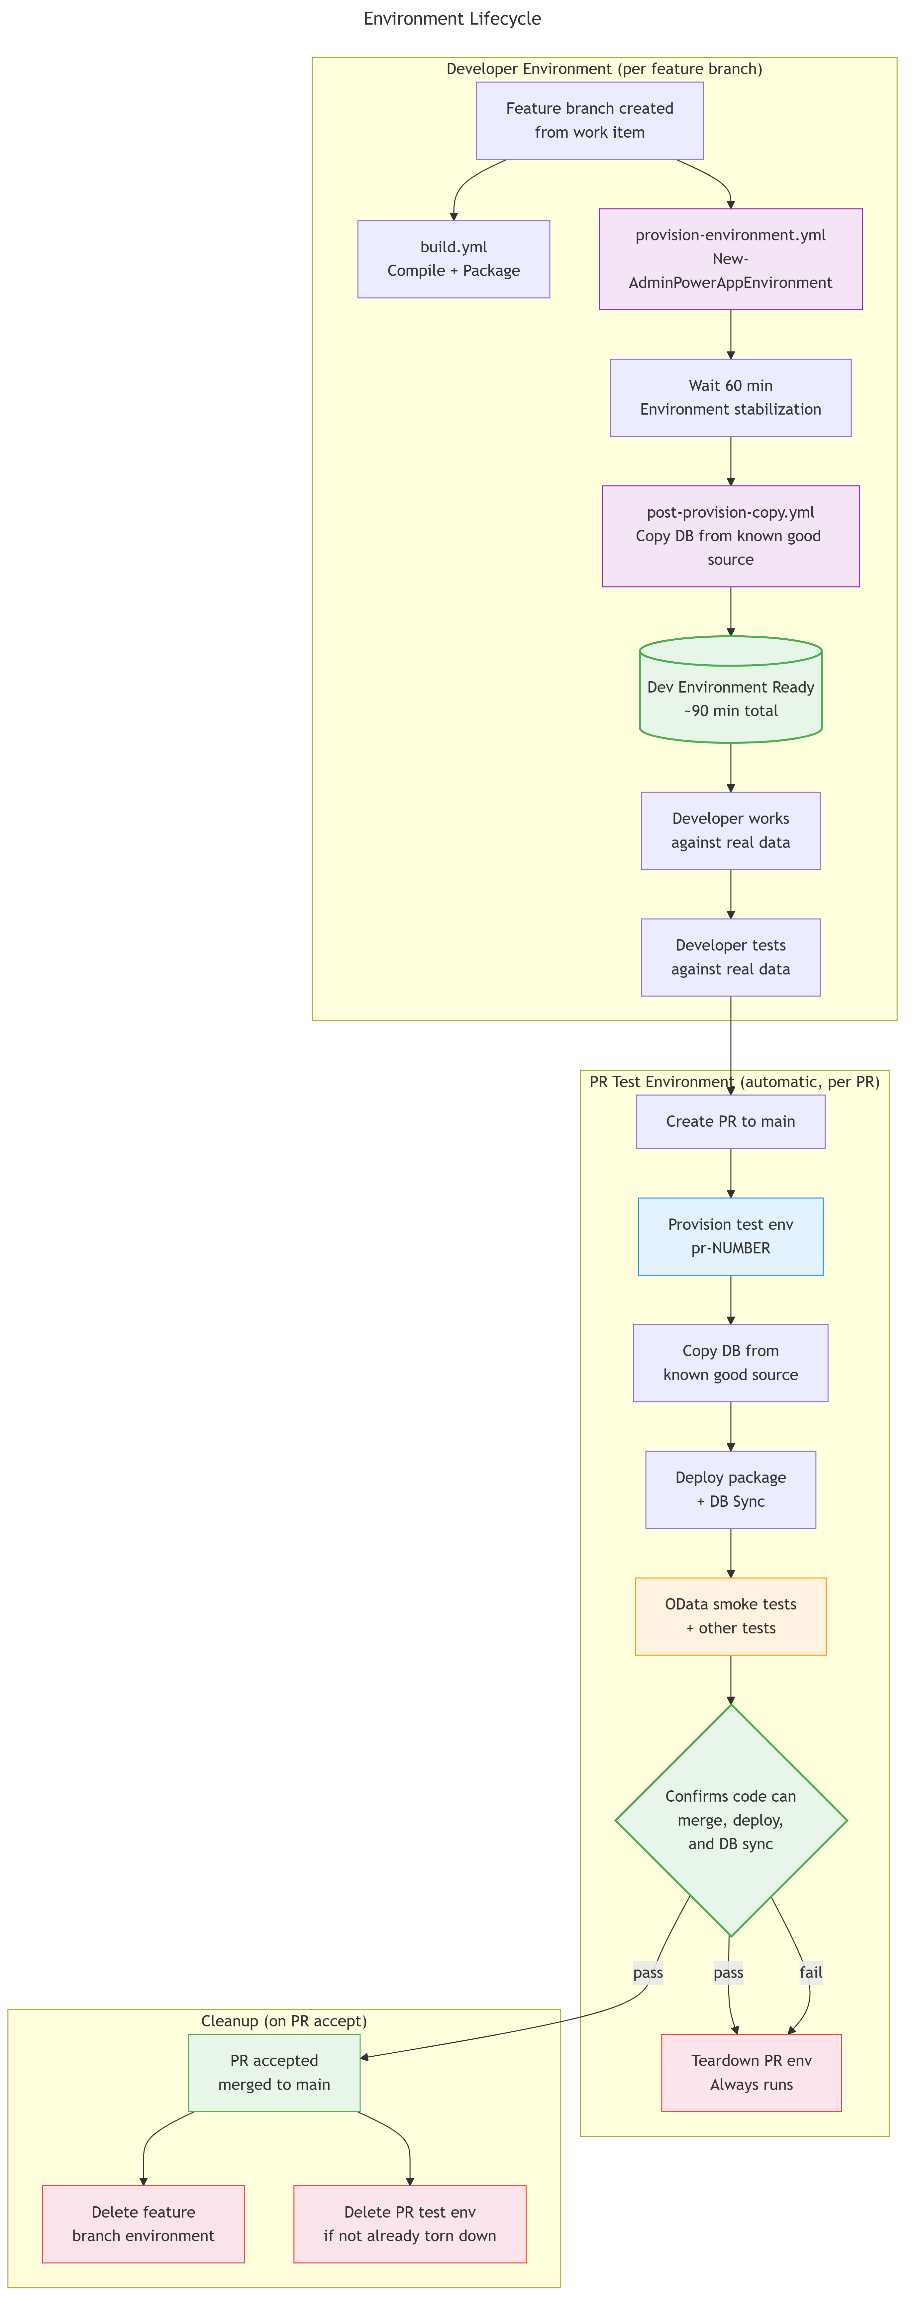
ENVIRONMENT LIFECYCLE

Slide 42
ENVIRONMENT LIFECYCLE

Slide 43
THE FULL DEVELOPMENT LIFECYCLE
Developer pushes feature branch
Sandbox created automatically
DB copied from known-good source
Developer tests with real data
PR created → automated test run, other automations run
PR merged → sandbox deleted
"Infrastructure as cattle, not pets."
Environments are disposable. The code is what matters.

Slide 44
POST-COPY AUTOMATION VIA DEVOPS
After database copy, automated steps run:
DMF entity refresh (new data entities published)
Environment validation checks
Service endpoint repointing
Reconfigure the environment to a set-point state
No manual steps between copy and ready-to-use
Common gotcha: SPN must be registered as F&O app user

Slide 45
SECURITY & GOVERNANCE
Defense-in-depth — multiple independent enforcement layers.

Slide 46
ENFORCEMENT LAYERS
Branch triggers → unauthorized code can't reach deploy
Pipeline chaining → can't skip validation stages
Environment approvals → human gate per environment
Service connection branch control → rogue pipelines blocked
Business hours restriction → no "on-hours" prod changes – you pick the schedule
Each layer is independent. Any single layer can fail and the others still hold. That's defense-in-depth.

Slide 47
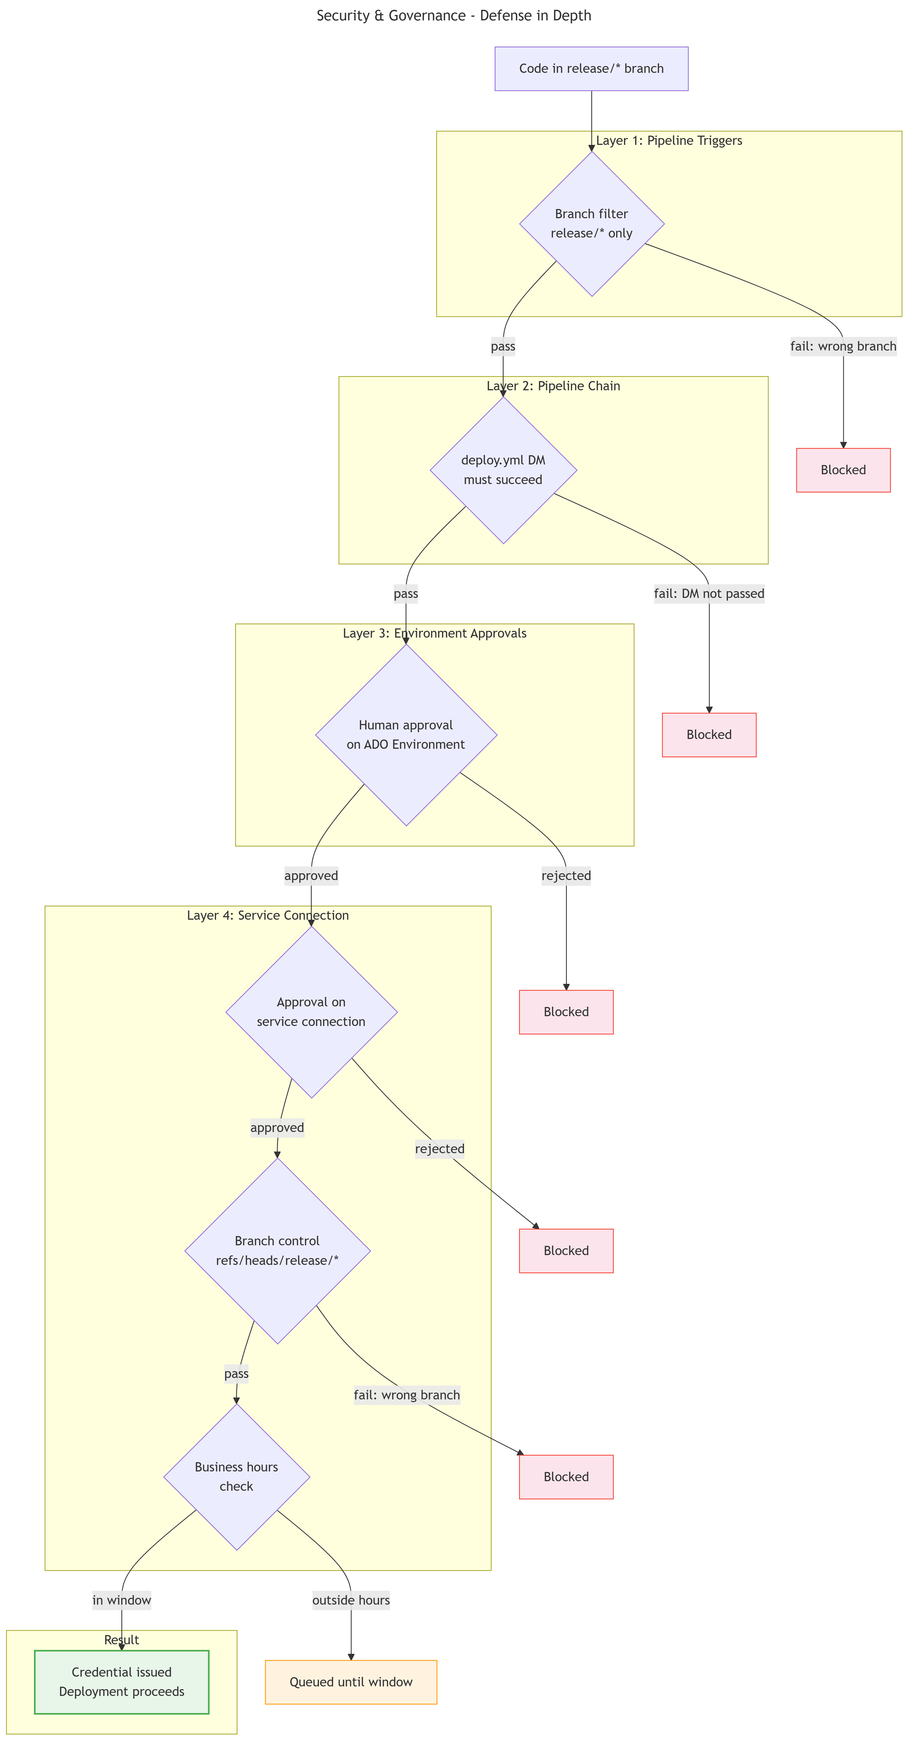
SECURITY LAYERS

Slide 50
SECURITY LAYERS

Slide 51
GETTING STARTED
You don't have to do everything at once.

Slide 52
THE MINIMUM VIABLE PIPELINE
Build pipeline — compile on hosted agents, publish artifact, cache nugets
PR validation — even just compile with or without basic tests
Deploy pipeline — promote the artifact, don't rebuild
Prerequisites:
Service principal registered with PPAC
NuGet feed with DevALM packages
One variable group for secrets (using key vault recommended but not required)

Slide 53
COMMON GOTCHAS
"Package DLL is invalid" → artifact path wrong upstream
Secrets empty in scripts → ADO secrets need macro syntax
PPAC API routing errors → use PowerShell module, not raw REST
Deploy cancels mid-apply → synchronous wait required
Build number format errors → must be #.#.#.# (no text)

Slide 54
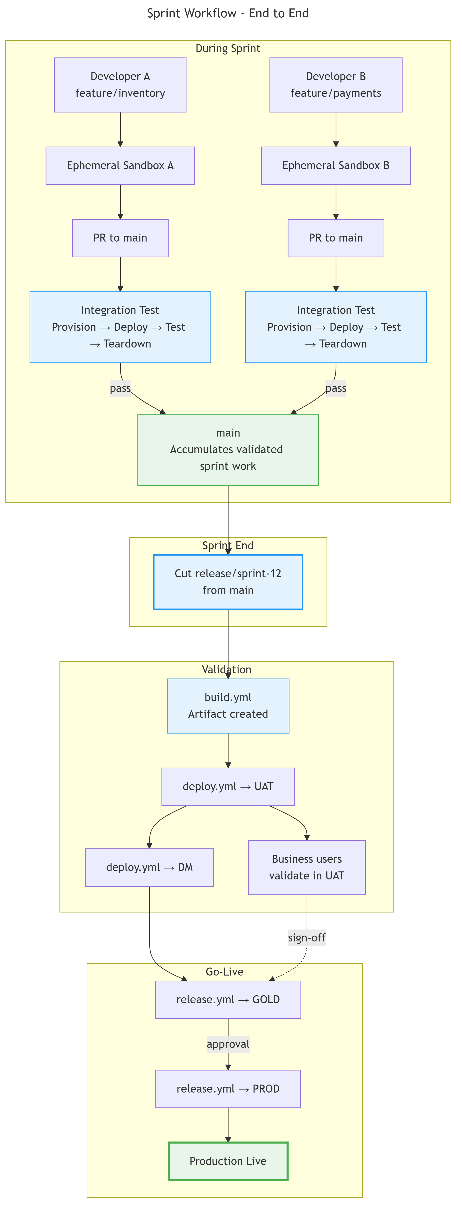
SPRINT WORKFLOW

Slide 57
SPRINT WORKFLOW

Slide 58
ONCE A DEPLOYABLE PACKAGE IS CREATED
it must never change. Only its fate does.

Slide 59
WHAT THIS DELIVERS
Immutable artifact — built once, promoted unchanged
Structural enforcement — (near) impossible to skip validation
Full automation — provision, copy, deploy, verify, cleanup
Zero drift — same binary, deterministic compilation
Start with build + PR validation.
You'll never go back to build VMs.
Everything we’ve talked about is available at https://github.com/NathanClouseAX/d365fo-cicd-ppac

Slide 60
Q & A
What's the one part of your current ALM process that keeps you up at night?

